Slide 1
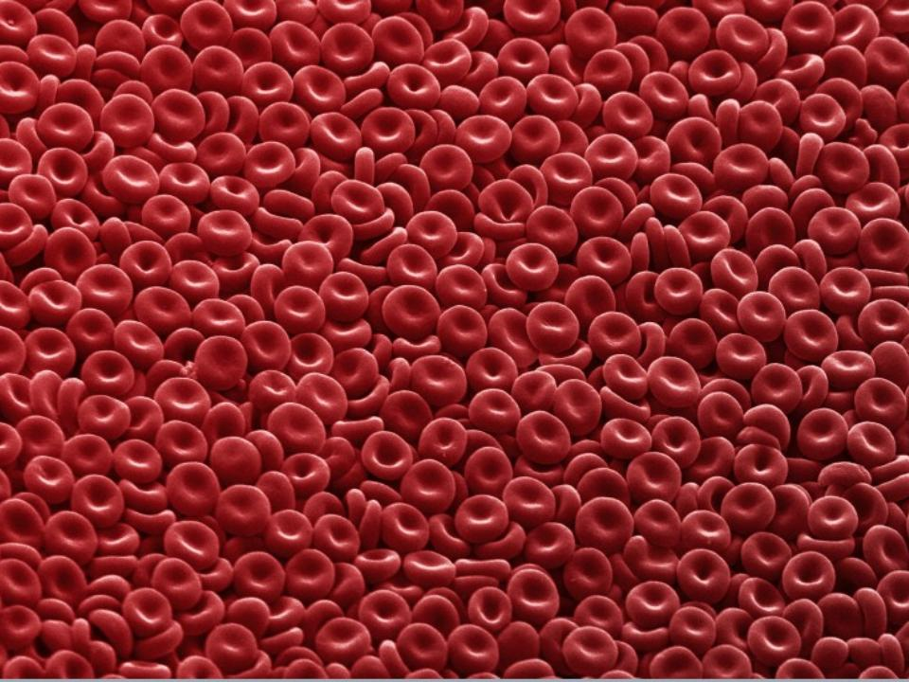
BLOOD DISORDERS

Slide 2
Carbon Monoxide Poisoning
CO binds to your hemoglobin, prevents oxygen from binding. Can be fatal. It is a "silent killer" as people often die in their sleep when a heater fails.
Carbon monoxide deaths are more likely to occur in winter
Article from 2010, St Clair County

Slide 3
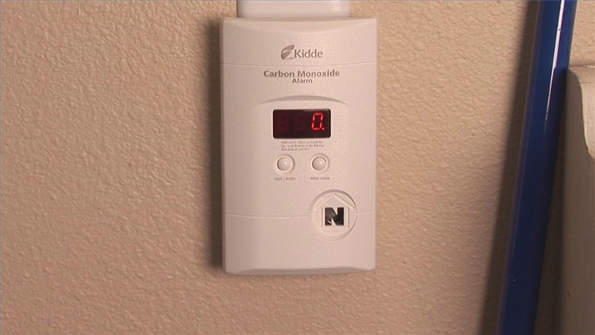

Slide 4
2. ANEMIA
Iron-Deficiency Anemia - low iron, most common
*treated with iron supplements
Aplastic Anemia – bone marrow does not produce enough RBC

Slide 5
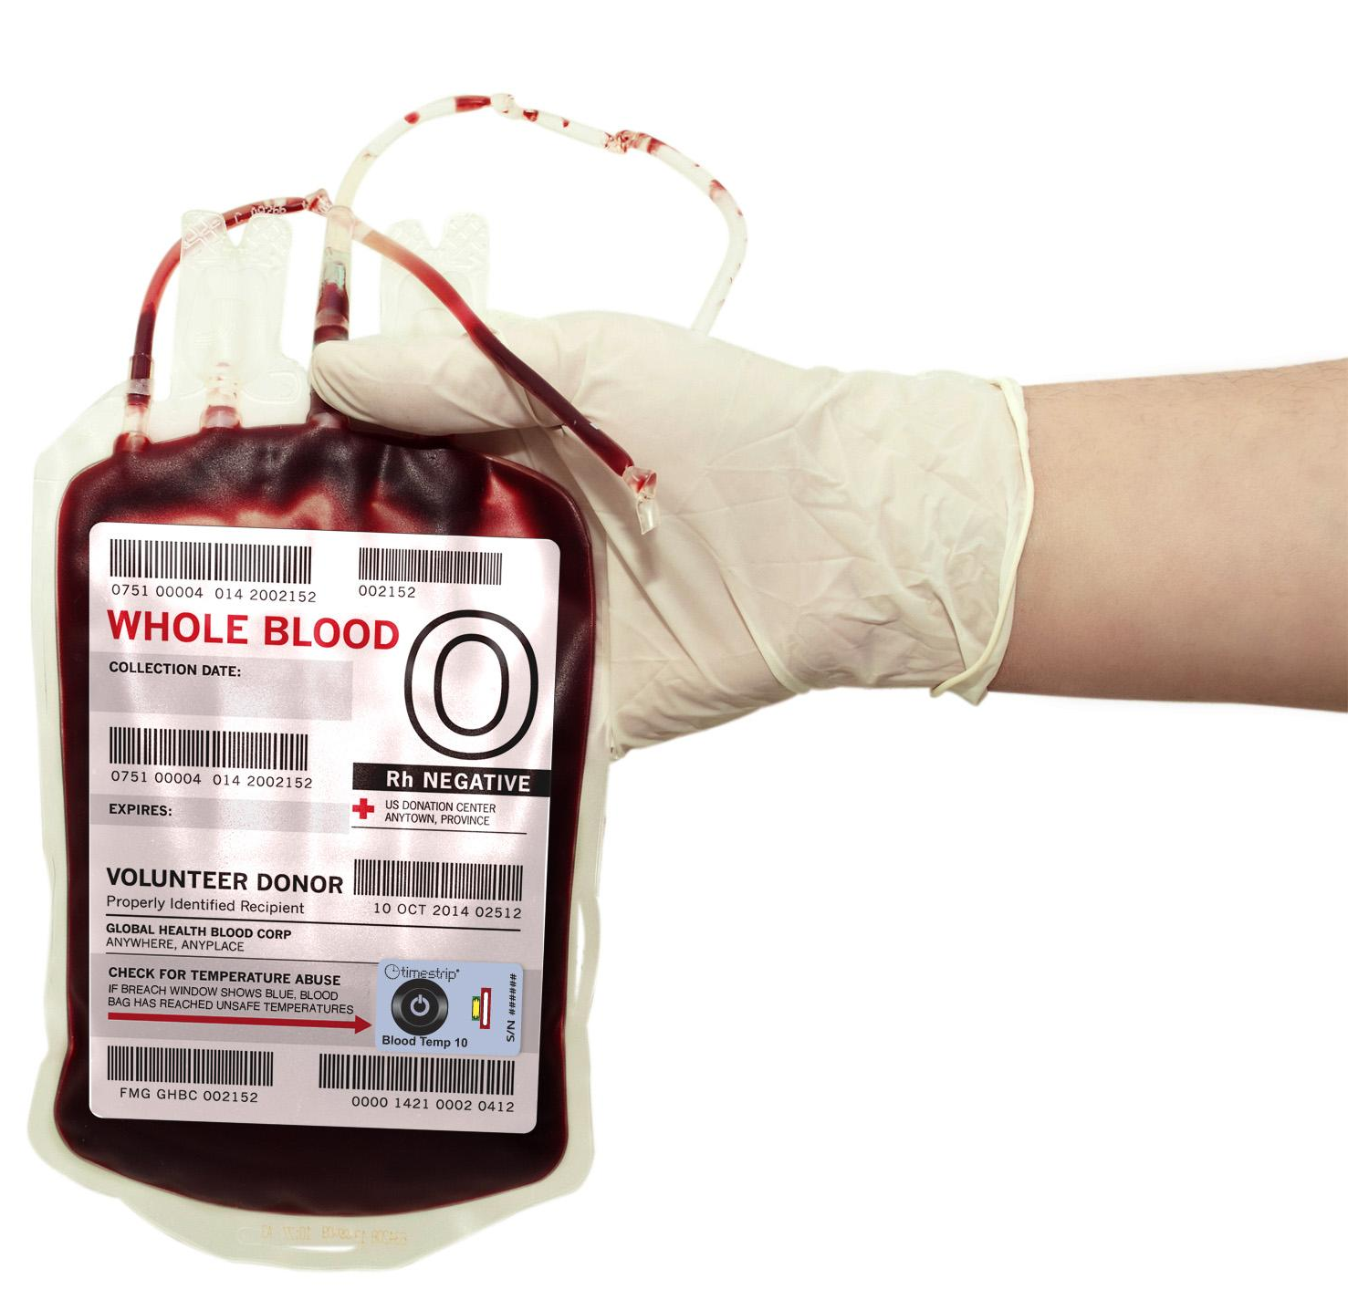
Hemorrhagic anemia – due to extreme blood loss
Pernicious anemia – B12 deficiency

Slide 6
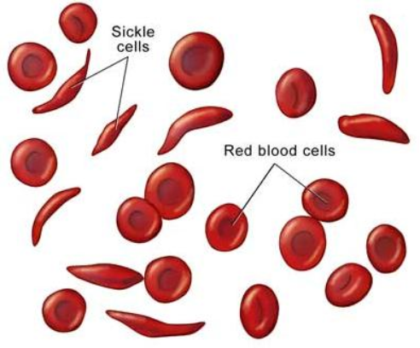
SICKLE CELL ANEMIA
Genetic Disorder
Abnormally shaped blood cells
Parents can be carriers (asymptomatic)

Slide 7
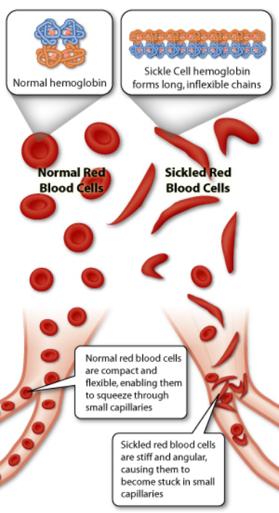
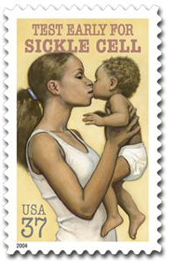
Symptoms:
Pain
Lethargy
Lifelong anemia (low red blood count)
Organ failure
Stroke

Slide 8
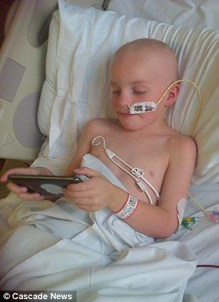
Leukemia
Cancer of the blood
Overproduction of wbc’s
They take the place of RBCs
Treatable with bone marrow transplants, chemotherapy, radiation

Slide 9
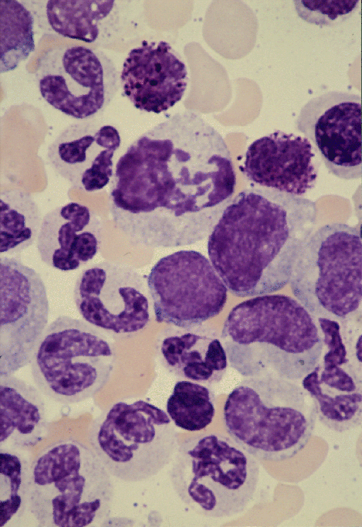
Blood Smear of a patient with Leukemia

Slide 10
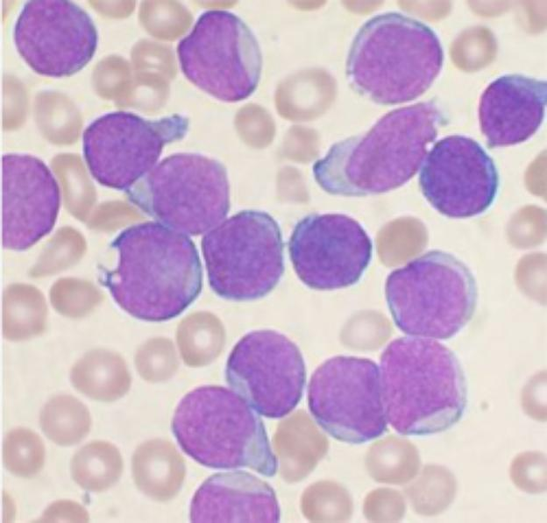
Blood Smear; Leukemia

Slide 11
St. Jude Hospital
Leukemia is one of the most common childhood cancers. It occurs when large numbers of abnormal white blood cells fill the bone marrow and sometimes enter the bloodstream.
Because these abnormal blood cells are defective, they don't help protect the body against infection the way normal white blood cells do. And because they grow uncontrollably, they take over the bone marrow and interfere with the body's production of other important types of cells in the bloodstream, like red blood cells (which carry oxygen) and platelets (which help blood to clot).

Slide 12
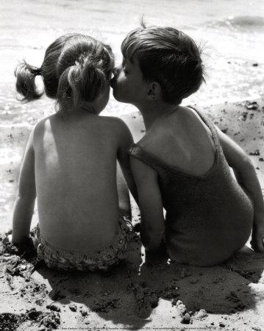
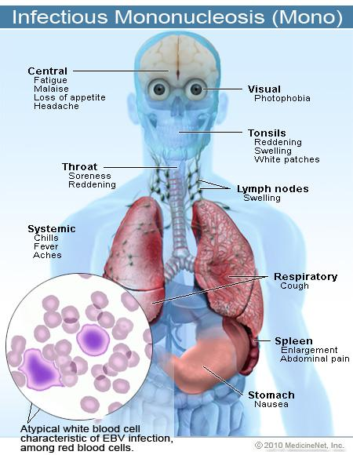
4. Mononucleosis
sometimes called "mono" or "the kissing disease," is an infection usually caused by the Epstein-Barr virus (EBV). The designation "mononucleosis" refers to an increase in one type of white blood cells (lymphocytes) in the bloodstream
EBV is very common, and many people have been exposed to the virus at some time in childhood.
Article at Medicinenet

Slide 13
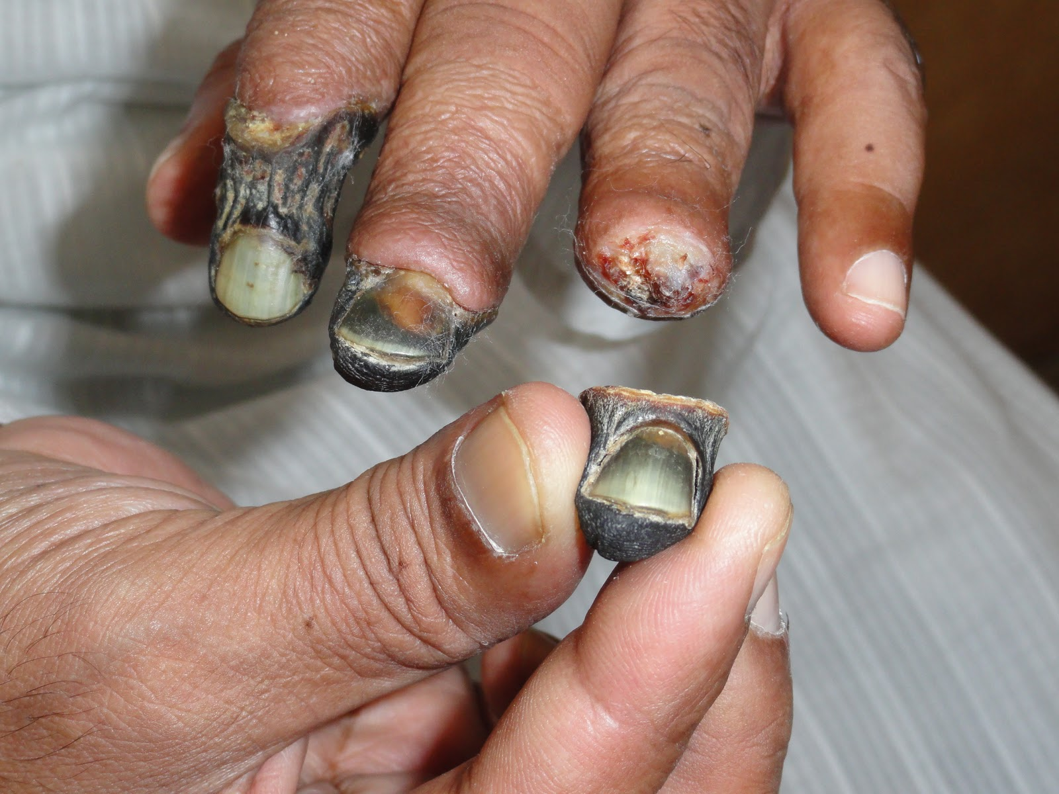
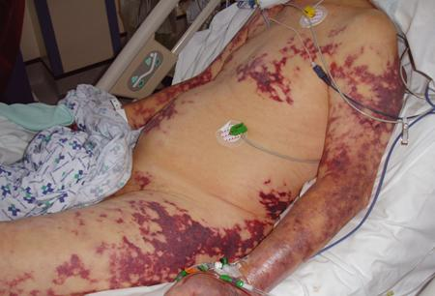
5. Blood poisoning - Septicemia
An infection enters the bloodstream
Can be deadly
Treated with antibiotics
Also called "sepsis"
Originating from the Latin and Greek terms gangreana, gangrene literally means degradation of a part of the living body.
autoamputation

Slide 14
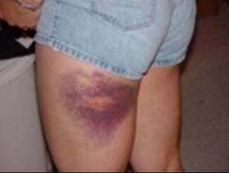
Thrombocytopenia
Low production of Platelets
Causes bleeding or bruising
A bruise is caused when tiny blood vessels are damaged or broken as the result of a blow to the skin (be it bumping against something or hitting yourself with a hammer).
The raised area of a bump or bruise results from blood leaking from these injured blood vessels into the tissues as well as from the body's response to the injury.

Slide 15
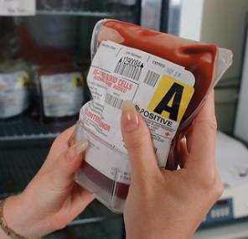
7. HEMOPHILIA
This disorder causes a failure of the blood to clot
Patients can be treated with blood transfusions that include clotting agents.

Slide 16
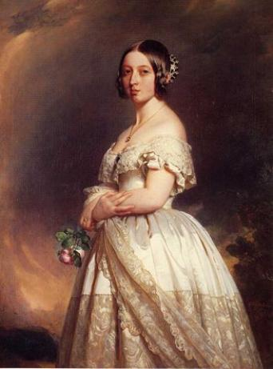
Queen Victoria
Carrier for Hemophilia

Slide 17
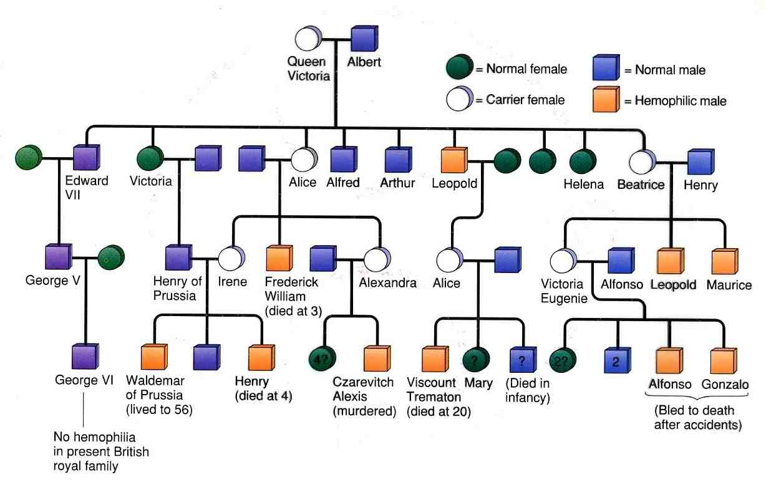

Slide 18
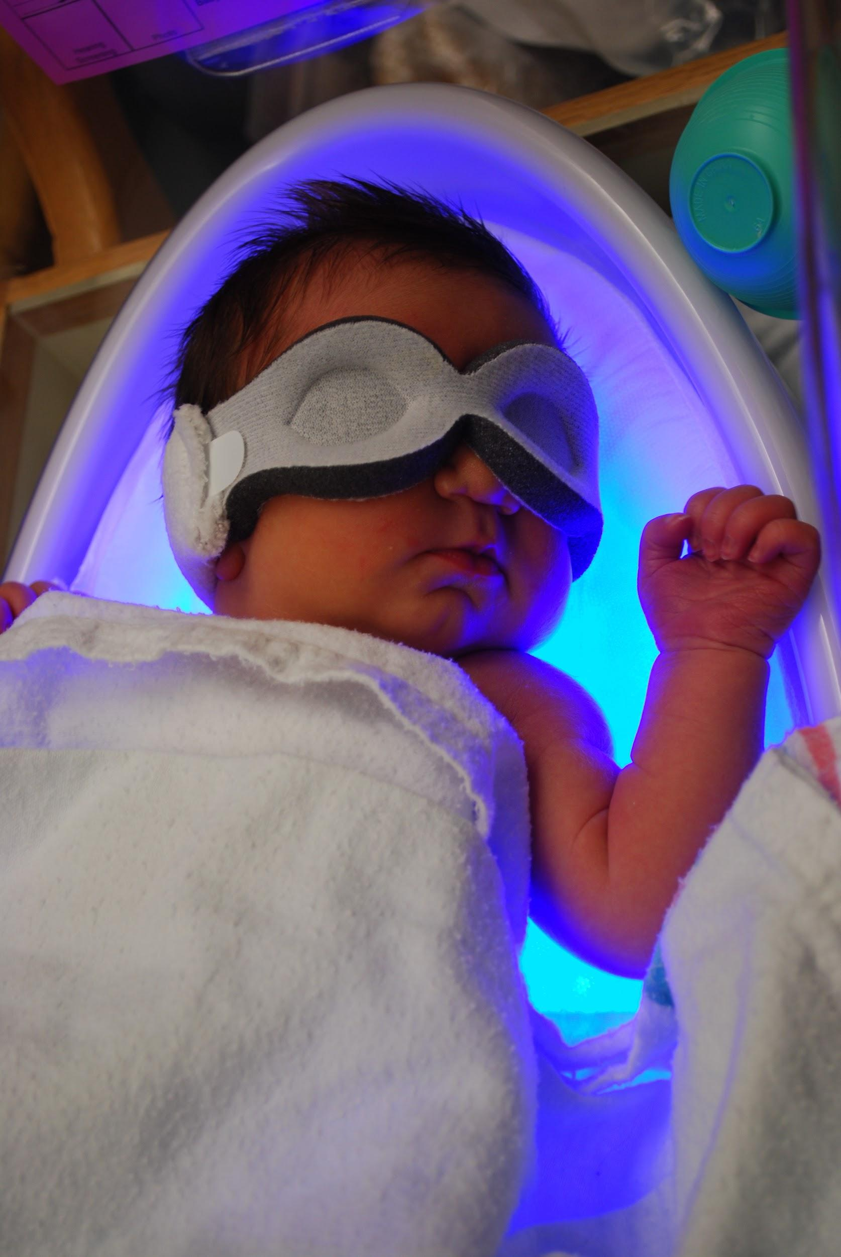
Jaundice
In newborns, caused by the liver not functioning fully.
Bilirubin builds up, causing a yellow color
Fluorescent lights (bili lights) used to treat condition

Slide 19
Quick Genetics Review
A gene consists of 2 alleles (represented by letters)
One allele is usually dominant over the other
Example:
Genotype Phenotype
PP widow’s peak
Pp widow’s peak
pp straight hairline

Slide 20
A person with a widow's peak (Pp) is married to a person with a straight hairline (pp), what percentage of their children will have a straight hairline?

Slide 21
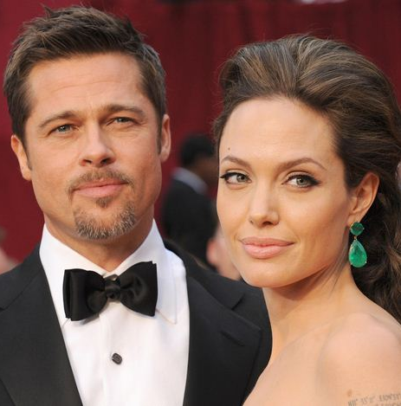
Two people who are both heterozygous for the widow's peak trait are married. What percentage of their children will have a straight hairline?

Slide 22
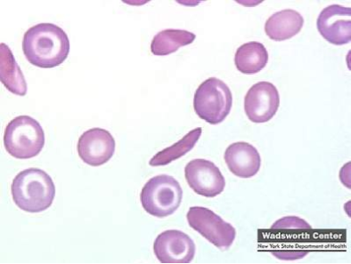
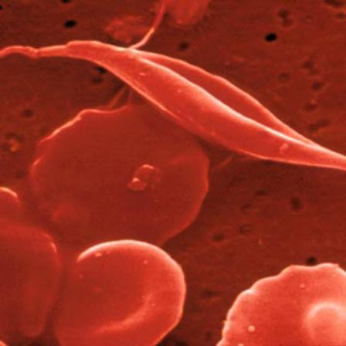
Sickle Cell Anemia is actually codominant
AA = normal
Aa = sickle cell trait (few symptoms) aa = sickle cell anemia

Slide 23
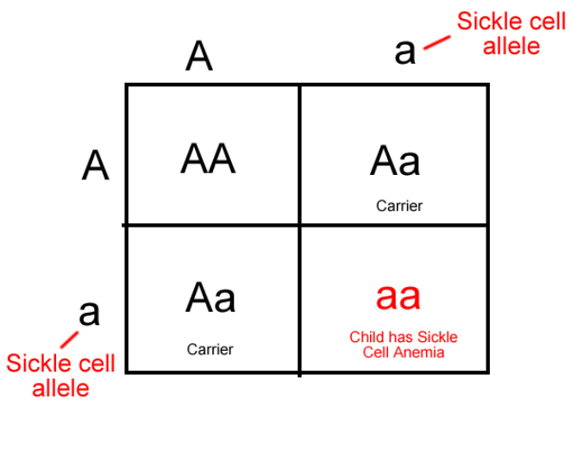
If both parents are carriers, child has a ¼ chance of having the disease

Slide 24
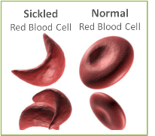
A female has sickle cell anemia and is married to a man who appears normal. A doctor tests the man and determines that he does NOT have sickle cell trait. What is the chance that this couple will have a child with sickle cell anemia?

Slide 25
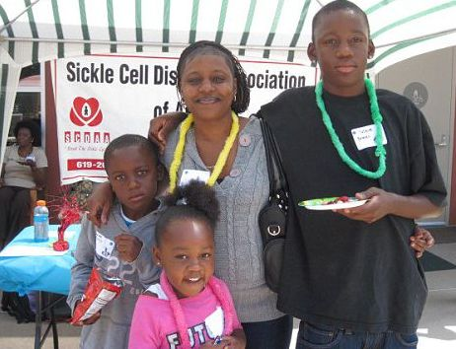
What happens when a female who is a carrier marries man with sickle cell anemia?

Slide 26
Hemophilia is carried on the X chromosome
Females X ^{H} X ^{H} normal
X ^{H} X ^{h} carrier
X ^{h} X ^{h} hemophiliac
Males X ^{H} Y normal
X ^{h} Y hemophiliac

Slide 27
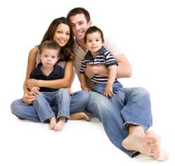
What happens when a female who is a carrier marries a normal man?

Slide 28
What happens when a female who is normal marries a man who has hemophilia?

